Slide 1



fullstackdatascience.com
Advanced SQL
MORE THAN JUST ARITHMETIC OPERATIONS
Created by Tien Hoang
DA K6
Lesson 3
TienHT@fullstackdatascience.com
1

Slide 2

Learn
About
01/
CTE AND SUBQUERY
02/
AGGREGATE AND
WINDOW FUNCTION
03/
BIGQUERY
fullstackdatascience.com
2

Slide 3
CTE
SUBQUERY
Introduction
A Subquery, also known as an inner query or nested query, is a query nested within another SQL query (the outer query). The subquery is executed first, and its result is used by the outer query.
A Common Table Expression (CTE) is a temporary named result set that you can reference within a SELECT, INSERT, UPDATE, or DELETE statement. CTEs improve the readability and structure of complex queries, especially when dealing with recursive data or when the same subquery is used multiple times.
3

Slide 4
When to use cte, subqueries
Scenario:
You have a table named sales with the following columns:
id: Unique identifier for each sale.
customer_id: ID of the customer who made the purchase.
amount: Sale amount.
sale_date: Date of the sale.
Question:
Let's find the customers who have made purchases above the average sale amount.
5

Slide 5

When to use cte, subqueries
SubQuery:
SELECT customer_id, amount
FROM sales
WHERE amount > (
SELECT AVG(amount) FROM sales
)
CTE:
WITH avg_sales AS (
SELECT AVG(amount) AS avg_amount FROM sales
)
SELECT customer_id, amount
FROM sales
WHERE amount > (SELECT avg_amount FROM avg_sales);
Subquery are useful for simple, one-time calculations.
CTEs are better when you need to reuse the result
multiple times or improve readability in complex queries.
5

Slide 6
KEY DIFFERENCES
 | Subqueries | CTE
Readability | Often harder and more difficult to maintain compared to CTE | Allow structuring and referencing queries in a modular fashion
Reusability | Cannot be referenced to multiple time | Can be referenced to multiple times
Recursion | Not support | Support recursive
Performance | Depends on databases
4

Slide 7
Excersice
Write a query to get the Phone and BusinessType of the Employeekey whose EmployeeKey code appears in the FactResellerSales table?
Ex1: Using Subquery
Ex2: Using CTE
Ex3: Join
5

Slide 8
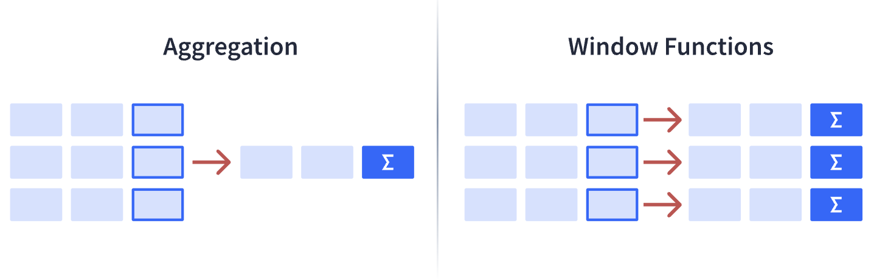
AGGREGATE
AND
WINDOW FUNCTION
3

Slide 9
Aggregate Function
The most commonly used SQL aggregate functions are:
MIN() - returns the smallest value within the selected column
MAX() - returns the largest value within the selected column
COUNT() - returns the number of rows in a set
SUM() - returns the total sum of a numerical column
AVG() - returns the average value of a numerical column
5

Slide 10
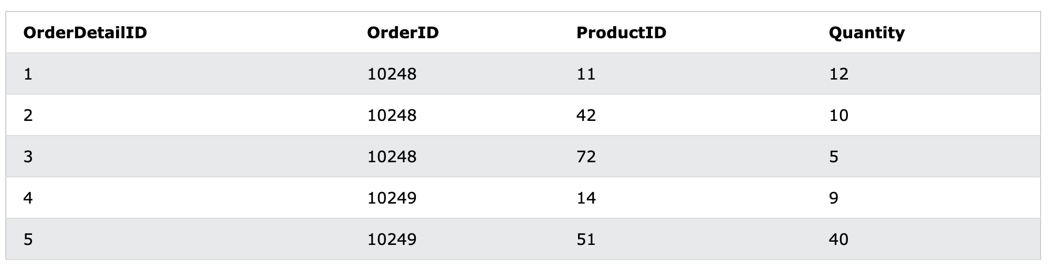
Aggregate Function
SELECT COUNT(*)
FROM OrderDetails;
SELECT SUM(Quantity)
FROM OrderDetails;
5

Slide 11
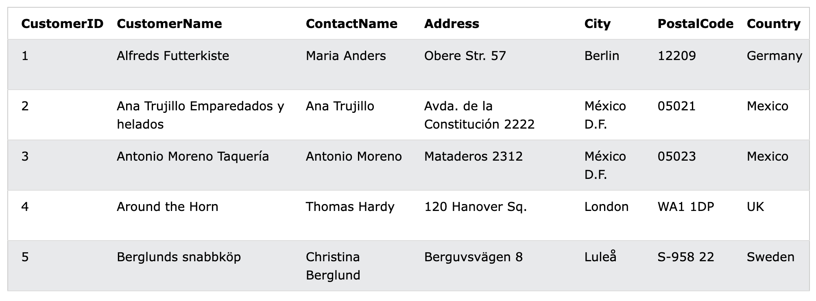
Aggregate Function
Group by
SELECT COUNT(CustomerID), Country
FROM Customers
GROUP BY Country;
5

Slide 12
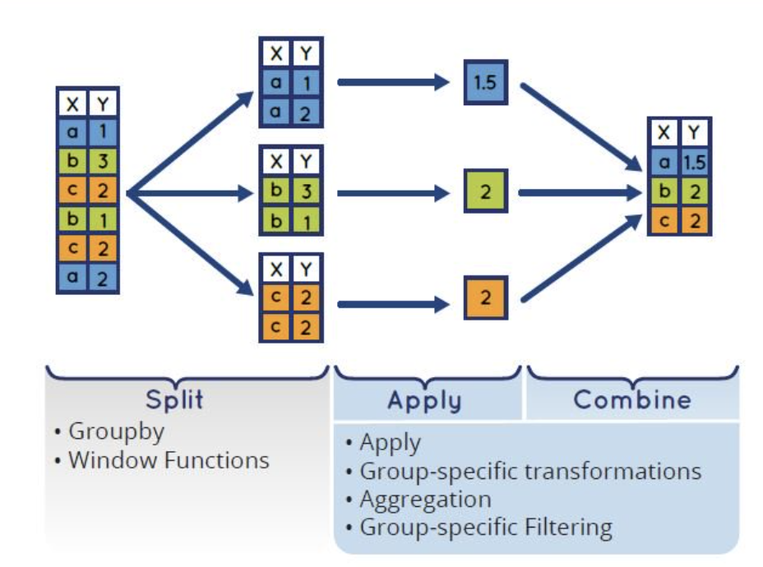
Aggregate Function
Group by
5

Slide 13
Excersice
Ex1. Write a query to determine the number of products by each Color in the DimProduct tables.
Ex2. Write a query that displays the count of orders placed by each year for each customer using the FactInternetsales table
Ex3. List the names and titles (FirstName, LastName, Title) of employees whose total sales (SalesAmount) is greater than the average of all employees.
Ex4. Viết truy vấn để tính tổng doanh thu được tạo ra bởi từng khách hàng (Gợi ý sử dụng FactInternetSales)
Ex5. Tìm top 3 CustomerKey tạo Doanh thu cao nhất
5

Slide 14
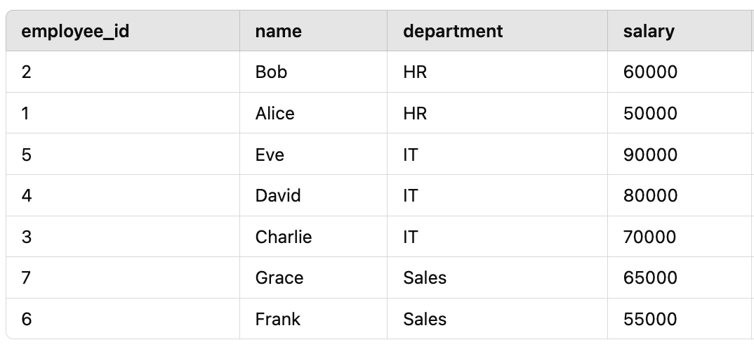
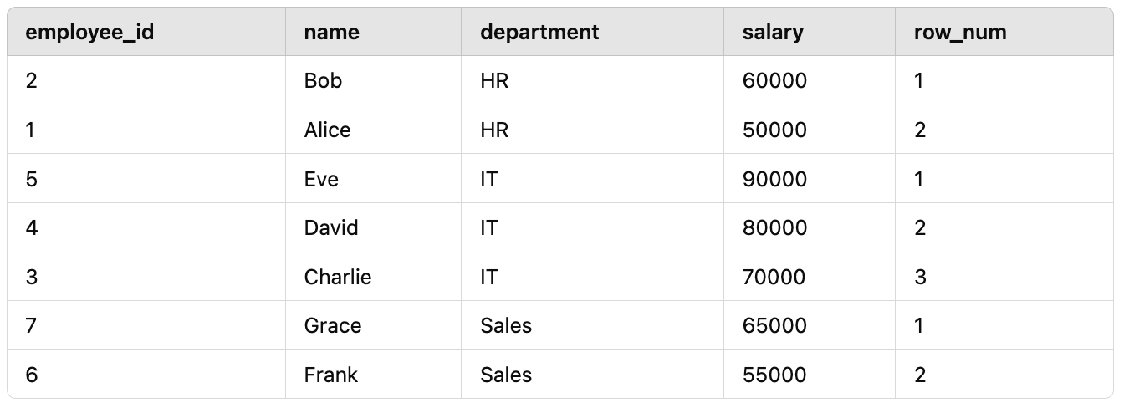
Window Function
Row_number()
SELECT
employee_id,
name,
department,
salary,
ROW_NUMBER() OVER (PARTITION BY department ORDER BY salary DESC) AS row_num
FROM employees;
5

Slide 15
Excersice
Find out 3 SaleOrderNumber with highest SalesAmount in InternetSales table
Ex1: Using row_number()
Ex2: Using rank()
Ex3. Hãy xếp hạng doanh thu được tạo ra bởi từng CustomerKey, theo từng Title của những CustomerKey đó (hãy sử dụng Bảng FactInternetSales và Dimcustomer)
5

Slide 16

BIGQUERY
3

Slide 17
Information Schema
Common INFORMATION_SCHEMA Views in BigQuery:
SCHEMATA: Information about datasets (schemas) in a project.
TABLES: Details about tables and views in a dataset.
COLUMNS: Metadata about columns within tables and views.
ROUTINES: Information about user-defined functions (UDFs) and stored procedures.
JOBS: Metadata about jobs (queries, loads, extracts).
PARTITIONS: Details about partitions in partitioned tables.
SELECT table_name, table_type
FROM hd-cooking.flat_data.INFORMATION_SCHEMA.TABLES;
5

Slide 18

fullstackdatascience.com
References
https://cloud.google.com/bigquery/docs
https://datahubproject.io/docs/
11

Slide 19





Thank you
096 574 90 25
CREATED BY
Nguyen Tien Huy
info@robusto.ai
fullstackdatascience
huynt@fullstackdatascience.com
Data Manager
https://fullstackdatascience.com/
Hanoi, Vietnam

